Slide 1

Fundamentals of Economics
M.M.L.C.Gunathilake
Senior Lecturer Gr II
Department of Management and Finance
General Sir John Kotelawala Defence University
Ratmalana

Slide 2

Theory of Demand
Lesson 02

Slide 3
Demand
Demand means the willingness and capacity to pay.
Effective Demand = Willingness to buy + Capacity to buy

Slide 4
Determinants of Demand.
The following factors determine the demand for a good:
  Price of the good (Px)
  Prices of related goods(P n-1)
    Complements and substitutes
  Income(I)
  Tastes(T)
  Government rules and regulations(G)
  Other(O)

Slide 5
Demand as a Function
ceteris paribus
Qd = f ( Px , P n-1 , I , T , G , O )
Quantity Demanded
x
Demand

Slide 6
Quantity Demanded
A schedule of the quantities of a good that buyers are willing and able to purchase at each possible price during a period of time, ceteris paribus. [all other things held constant]”

Slide 7
Demand schedule vs. Demand curve
Demand schedule is one way of showing the relationship between quantity demanded and price. It is a numerical tabulation that shows the quantity that will be demanded at some selected prices.
The demand curve shows the complete relationship between quantity demanded and price.

Slide 8
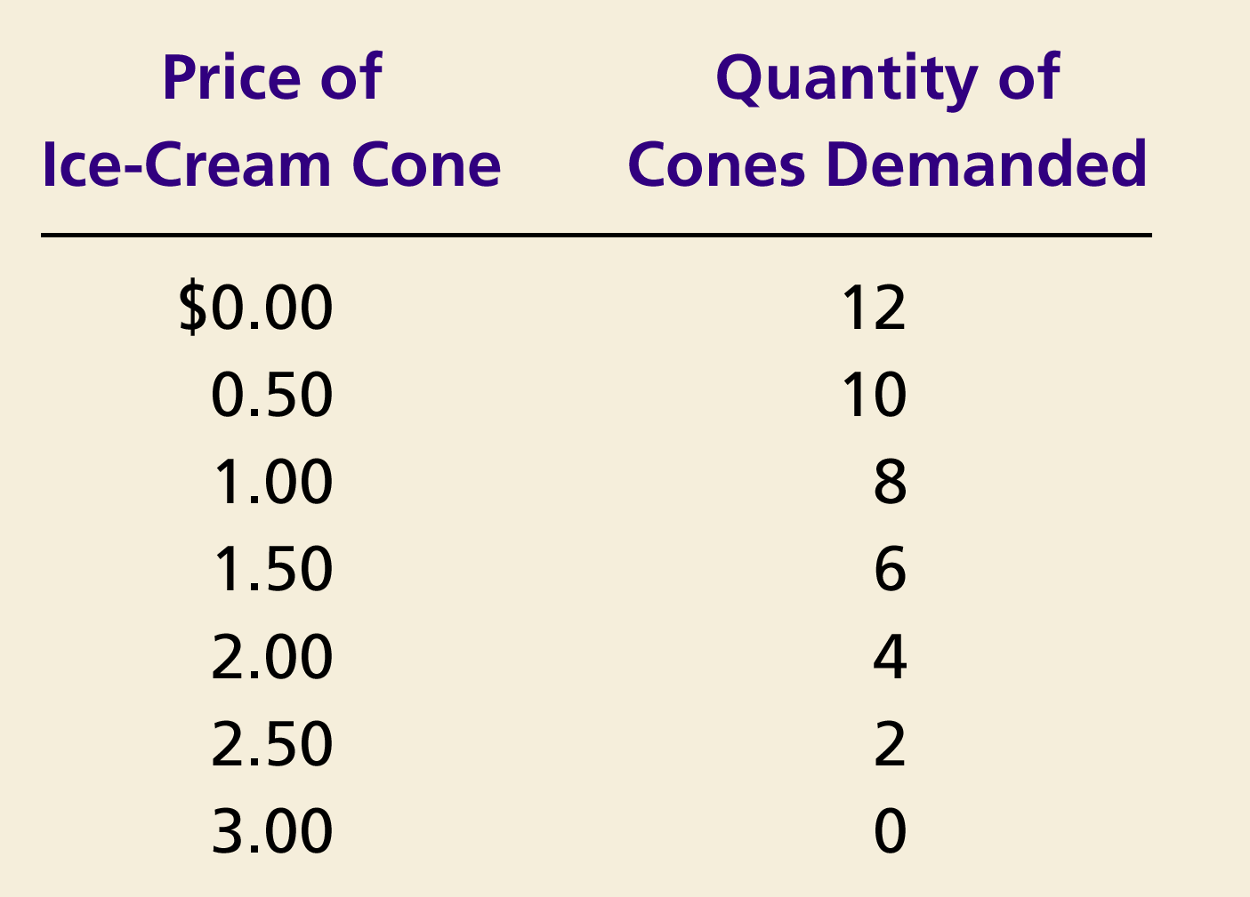
Ex: Individual Demand Schedule and Demand Curve
Price of
Ice-Cream Cone
$3.00
2.50
1. A decrease
2.00
in price
...
1.50
1.00
0.50
0
1
2
3
4
5
6
7
8
9
10
11
12
Quantity of
Ice-Cream Cones
2.
...
increases quantity
of cones demanded.
Copyright © 2004 South-Western

Slide 9
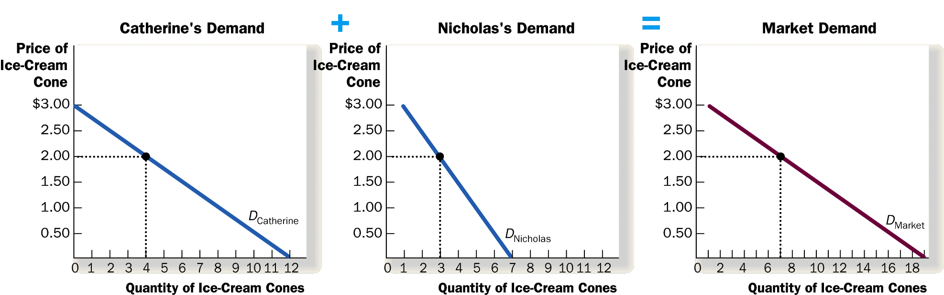
Market Demand is the Sum of Individual Demands
C = 1000
N = 500
Qd = 1500

Slide 10
Market demand
The total quantity depends on the price of the product being sold, on the prices of all other products, on the incomes of the individuals buying in that market, and on their tastes. The market demand curve relates the total quantity demanded to the product’s own price, on the assumption that all other prices, total income, tastes and all other environmental factors held constant.

Slide 11
Law of Demand
The law of demand states that
  the quantity demanded of a good falls when the price of the good rises, and vice versa, provided all other factors that affect buyers’ decisions are unchanged.
  In formulating the demand theory assume that each individual consumer is a rational decision maker who seeks maximum satisfaction or well-being or utility.
  Refer : Law of diminishing marginal utility

Slide 12
law of diminishing marginal utility
“The law of diminishing marginal utility states that, “as a consumer consumes more and more units of a specific commodity, utility from the successive units goes on diminishing”.

Slide 13
Suppose a person is thirsty and the price of water is zero. He takes one glass of water which gives him great satisfaction. We can say the first glass of water has great utility for him.
He then takes second glass of water. The utility of the second glass of water is less than that of first glass of water. The utility declines because the edge of his thirst has been blunted to a great extent.
If he drinks third glass of water, the utility of the third glass will be less than that of second and so on. The utility goes on diminishing with the consumption of every successive glass of water till it drops down to zero.
It is the position of consumer’s equilibrium or maximum satisfaction.
If the consumer is forced further to take a glass of water, it leads to disutility causing total utility-to decline. The marginal utility will become negative. A rational consumer will stop taking water at the point at which marginal utility becomes negative even if the good is free.

Slide 14
The following table will make the law of diminishing marginal utility more clear.
Units | Total Utility | Marginal Utility
1st glass | 20 | 20
2nd glass | 32 | 12
3rd glass | 40 | 8
4th glass | 42 | 2
5th glass | 42 | 0
6th glass | 39 | –3

Slide 15
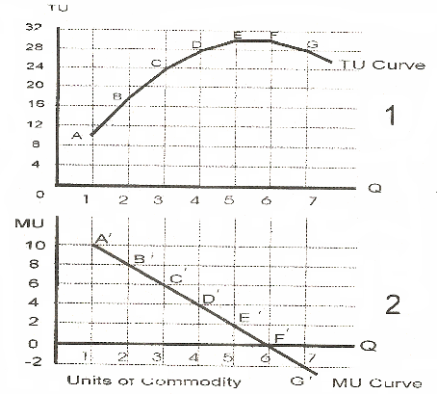

Slide 16
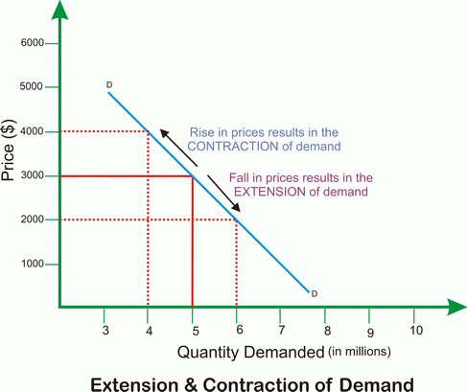
Effects of the Law of Demand

Slide 17
Shifts in the Market Demand Curve
… are caused by changes in:
  Consumer income
  Prices of related goods
  Tastes
  Expectations, say, about future prices and prospects
  Number of buyers
Notes:
11

Slide 18
Shifts in the Demand Curve
Price of
Ice-Cream
Cone
Increase
in demand
Decrease
in demand
Demand
curve,
D
2
Demand
curve,
D
1
Demand curve,
D
3
0
Quantity of
Ice-Cream Cones

Slide 19
Shifts in the Demand Curve
Consumer Income
  As income increases the demand for a normal good will increase
  As income increases the demand for an inferior good will decrease
Prices of Related Goods
  When a fall in the price of one good reduces the demand for another good, the two goods are called substitutes
  When a fall in the price of one good increases the demand for another good, the two goods are called complements
Price
Quantity Demanded

Slide 20
The Law of Demand—Explanations
There are two ways to explain the Law of Demand
  Substitution effect
  Income effect
Price Effect = Substitute Effect + Income Effect

Slide 21
Substitution Effect
When the price of a good decreases, consumers substitute that good instead of other competing (substitute) goods
1. When the price of Coke decreases…
2. Consumption of Coke increases
3. Consumption of Pepsi decreases
Clothes
Coke
Books
Movies
Pepsi

Slide 22

Rs 80
Coca Cola
Rs 40
What If Coca cola price deduced up to Rs 20
Now, Consumer can buy four Soft drink Bottles

Slide 23
Income Effect
A decrease in the price of a commodity is essentially equivalent to an increase in consumers’ income.
Decrease in the price = Increase in consumers’ Income

Slide 24
Lower Prices = Higher Income
Situation A
Price of an Apple | $1.00
Price of an Orange | $2.00
Income | $10.00
If income rises, Situation A becomes Situation B.
Situation B
Price of an Apple | $1.00
Price of an Orange | $2.00
Income | $20.00
If prices fall, Situation A becomes Situation C.
Situation C
Price of an Apple | $0.50
Price of an Orange | $1.00
Income | $10.00
Q: Which change is better?
A: They are both equally desirable. A fall in prices is equivalent to an increase in income.

Slide 25
Income Effect
Consumers respond to a decrease in the price of a commodity as they would to an increase in income
They increase their consumption of a wide range of goods, including the good that had a price decrease
1. When the price of Coke decreases…
2. Consumers feel richer…
3. Consumption of Coke and other normal goods increases
Clothes
Coke
Books
Movies
Pepsi

Slide 26
Exceptions to the Law of demand
Situations where there will be a positive relationship between quantity demanded and the price of the product.
  Veblin effect : Goods having prestige value
  Giffin goods/effect

Slide 27
The END

